Slide 1
Third-Party Landing Zone (3PLZ) – RFP Overview
Vendor-Neutral Requirements for Self-Service Third-Party Connectivity Solution
Michael J. Martin
Network Security Engineering
Notes:
This deck summarizes the requirements for a Third-Party Landing Zone platform as defined in our RFP.
The key themes are vendor-neutral design, clear service patterns, a self-service portal experience, and strong automation.
We’re not looking for just another VPN product. We’re looking for a platform that application teams can consume through a web portal and APIs.

Slide 2
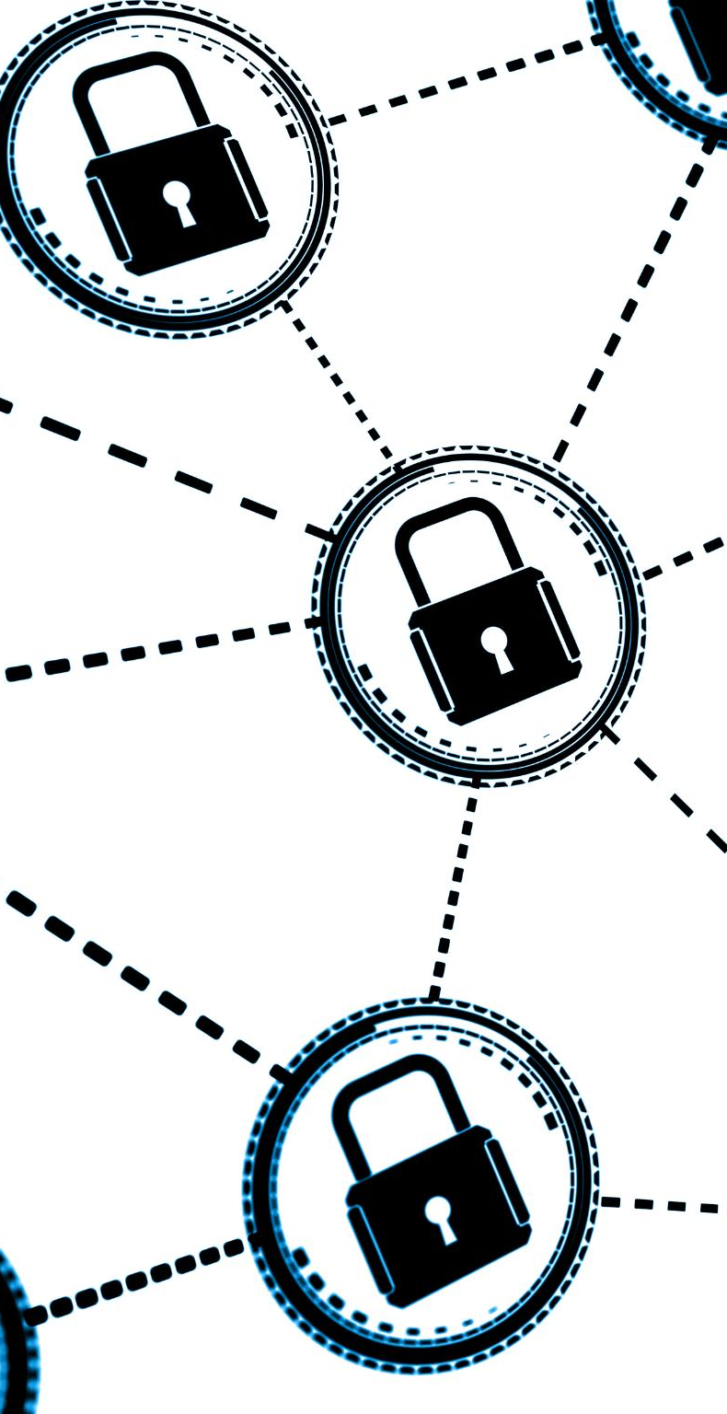
A Case For Change
Traditional enterprise approaches to third-party connectivity are no longer sufficient. They lack isolation, auditability, and scalability—creating security gaps and reducing business agility. Manual processes introduce inefficiencies and increase risk, while growing third-party interactions amplify these challenges. At the same time, evolving regulatory requirements and sophisticated cyber threats demand a standardized, automated approach that enforces least privilege, segmentation, and identity-aware controls to ensure compliance and operational resilience.
To address these challenges, the enterprise must transition from insecure, unsupportable legacy models to a modern, service-oriented capability. This new approach empowers business units through self-service onboarding, automation, and end-to-end governance, delivering a secure, repeatable, and compliant connectivity framework that accelerates time-to-market while reducing operational risk.
Notes:
Communication with external vendors is essential for business success, yet it introduces significant security and operational risks. Traditional connectivity models often lack the necessary isolation, auditability, and scalability required to safeguard enterprise applications. These models typically rely on manual processes that hinder agility and increase complexity, making it difficult for organizations to adapt quickly to evolving business needs. The absence of a standardized, secure, and automated approach to vendor connectivity exposes the enterprise to potential vulnerabilities and inefficiencies. As the volume and diversity of third-party interactions grow, the limitations of existing connectivity solutions become more pronounced, necessitating a transformative approach that addresses both technical and operational challenges.

Slide 3

Delivering Change a Strategic Shift
Empowering Application Teams
This shift enables application teams to independently manage connectivity through a self-service, outcome-driven model, reducing reliance on centralized processes and accelerating delivery
Alignment with DevOps
By allowing teams to build, run, and own their connections securely, this approach reinforces DevOps principles and promotes agility across the enterprise.
Automation and Scalability
Automated delivery frameworks ensure consistent, repeatable, and scalable connectivity, while embedding compliance and governance controls into every step.
Operational Efficiency and Ownership
The strategic shift fosters enterprise-wide efficiency, reducing manual effort and reinforcing a culture of ownership and accountability for secure connectivity.
Notes:
The implementation of the 3PLZ represents a strategic shift from viewing third-party connectivity as a purely technical product to delivering a self-service, process-outcome based solution. This new paradigm leverages automation to provide tangible business value, empowering application development teams to manage their own connectivity needs. By aligning with the DevOps philosophy of 'build, run, own,' the solution enables teams to migrate existing connections independently while maintaining adherence to security best practices. The self-service model fosters agility and innovation, allowing teams to respond quickly to changing requirements. Furthermore, the automated delivery framework ensures consistency and scalability, supporting enhanced capabilities and controls as the organization evolves. This shift not only improves operational efficiency but also reinforces a culture of ownership and accountability within the enterprise.

Slide 4
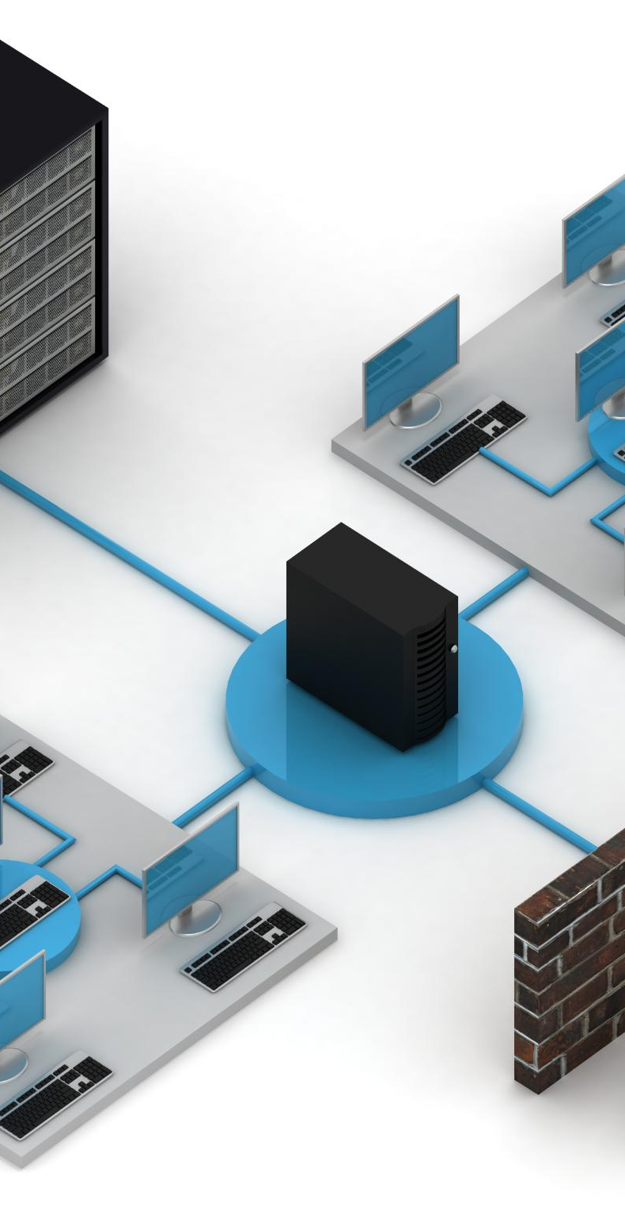
Proposed Way Forward: 3PLZ
Standardized IPSec Connectivity
The solution delivers secure, standardized IPSec VPN connectivity for third-party access, supporting leading platforms such as Cisco, Arista, Palo Alto, and Fortinet. Configurations are validated through virtual lab testing and require only basic, easily collectable data points for deployment.
Connectivity supports peer-to-peer routing via BGP or static IP, restricted exclusively between the Virtual Tenant and the third-party network. All communication between third parties and the enterprise occurs through application-specific proxies, ensuring isolation and security.
The architecture employs Active/Passive HA with a single tunnel design, featuring unique per-tenant IP tunnel endpoints for clear segmentation.
Virtual Tenant Architecture
The Virtual Landing Zone operates on a split-brain proxy model, maintaining separate routing domains for third-party and enterprise environments. It includes DNS rewriting capabilities, enabling declarative forwarding for enterprise domains (public and private FQDNs), with responses contingent on successful authoritative lookups. A unique per-tenant/proxy addressing model ensures strong isolation and traceability across all connections.
Notes:
This slide summarizes the strategic and architectural foundation of the Third-Party Landing Zone. Our goal is to deliver secure, repeatable, and compliant connectivity for third-party use cases.
The solution is built on a VPN-based architecture that isolates external access and enforces granular controls through service-specific proxies. These proxies support least privilege, segmentation, and auditable access, ensuring that vendor interactions are tightly governed.
Automation and self-service onboarding reduce manual operations, improving agility and scalability. The platform aligns with key compliance frameworks like SOC 2, ISO 27001, and NIST standards, while also incorporating identity-aware controls and high availability to support enterprise-grade reliability.

Slide 5
Vision for A 3rd Party Landing Zone
Secure Tenant Architecture
Deliver a secure and compliant third-party connectivity solution by implementing IPSec VPN tunnels to a Virtual Landing Zone, ensuring isolation and protection of enterprise applications from external access. This architecture aligns with SOC 2, ISO 27001, and NIST CSF / 800-171 / 800-207 standards, providing a governance-driven approach that meets regulatory and security requirements.
Granular Access Control
Enforce per-partner connectivity through service-specific proxies within the Virtual Landing Zone, applying least-privilege principles and segmentation to deliver auditable, fine-grained access. Identity-aware controls strengthen the security posture by ensuring access decisions are context-driven and aligned with organizational policies.
Repeatable, Compliant Connectivity through Automation and Self-Service Onboarding
Streamline partner onboarding and minimize manual effort, accelerating time-to-market while enhancing governance and reducing operational risk. Delivered via an intuitive self-service portal, this solution provides a secure, standardized connectivity framework with a pre-hardened environment for quick, consistent onboarding. Easy-to-deploy interfaces and minimal configuration ensure a seamless experience while maintaining strict compliance with industry security standards.
Notes:
This slide summarizes the strategic and architectural foundation of the Third-Party Landing Zone. Our goal is to deliver secure, repeatable, and compliant connectivity for third-party use cases.
The solution is built on a VPN-based architecture that isolates external access and enforces granular controls through service-specific proxies. These proxies support least privilege, segmentation, and auditable access, ensuring that vendor interactions are tightly governed.
Automation and self-service onboarding reduce manual operations, improving agility and scalability. The platform aligns with key compliance frameworks like SOC 2, ISO 27001, and NIST standards, while also incorporating identity-aware controls and high availability to support enterprise-grade reliability.

Slide 6






Service Pattern Catalog (Initial Use Cases)
Secure File Transfer – SFTP / SSH / MFT (e.g., IBM Sterling)
Collaboration Access – M365, eShare, Slack via proxied, logged access
Virtual Desktop (VDI) – Citrix / Microsoft VDI via per-tenant proxies
Web Applications – Internal HTTPS apps via reverse proxies with mTLS
Web APIs – REST/SOAP APIs with mTLS and token/claim-based controls
Each pattern must support both Enterprise and Internet/SaaS paths
Notes:
The platform is defined around service patterns, not raw network reachability.
We require at least five core patterns: secure file transfer; collaboration access; virtual desktop; internal web applications; and web APIs.
Each pattern must be implemented as an opinionated, secure service, with per-tenant proxies and policies.
We expect support for both enterprise paths, where traffic terminates in internal environments, and internet or SaaS paths, where traffic goes through controlled egress to external services.

Slide 7
High Level Architectural
Notes:
The platform is defined around service patterns, not raw network reachability.
We require at least five core patterns: secure file transfer; collaboration access; virtual desktop; internal web applications; and web APIs.
Each pattern must be implemented as an opinionated, secure service, with per-tenant proxies and policies.
We expect support for both enterprise paths, where traffic terminates in internal environments, and internet or SaaS paths, where traffic goes through controlled egress to external services.

Slide 8
Appendix
Notes:
The platform is defined around service patterns, not raw network reachability.
We require at least five core patterns: secure file transfer; collaboration access; virtual desktop; internal web applications; and web APIs.
Each pattern must be implemented as an opinionated, secure service, with per-tenant proxies and policies.
We expect support for both enterprise paths, where traffic terminates in internal environments, and internet or SaaS paths, where traffic goes through controlled egress to external services.

Slide 9
Self-Service Portal Experience
Web portal is the primary front door for application teams and product managers to deliver capabilities.
“Shift Left” Delivery approach.
Embracing the KISS principle.
Web and API driven delivery interface enabling easy adoption for both technical and not-technical users.
Service and pattern driven configuration, built on easily collected data
No deep network expertise required for requestors. Portal delivers tested configurations based on well defined patterns.
Notes:
The platform is defined around service patterns, not raw network reachability.
We require at least five core patterns: secure file transfer; collaboration access; virtual desktop; internal web applications; and web APIs.
Each pattern must be implemented as an opinionated, secure service, with per-tenant proxies and policies.
We expect support for both enterprise paths, where traffic terminates in internal environments, and internet or SaaS paths, where traffic goes through controlled egress to external services.

Slide 10
Virtual Landing Zone (VLZ) & Tenant Model
Virtual Landing Zone
Secure Tenant Model
Each third-party connection is a dedicated tenant (VLZ)
Provides the enterprise side of the Peer 2 Peer IPSec tunnel
Single HA-FT IPSec Connection per VLZ
VLZ is a no-access zone: no direct routing to internal networks
Virtual Landing Zone is physical, but discrete (A tenant can have more than one VLZ)
A Tenant is logical (more than one VLZ can exist in a tenant)
Each tenant is a unique identity, mapped to a business identity
  A VLZ is owned by tenant
Each VLZ is distinctive:
  Address blocks
  Tunnel interfaces,
  EBGP ASN
  DNS Resolver
  Service Connections
Availability is built around applications using FQDN reachability
Notes:
The platform is defined around service patterns, not raw network reachability.
We require at least five core patterns: secure file transfer; collaboration access; virtual desktop; internal web applications; and web APIs.
Each pattern must be implemented as an opinionated, secure service, with per-tenant proxies and policies.
We expect support for both enterprise paths, where traffic terminates in internal environments, and internet or SaaS paths, where traffic goes through controlled egress to external services.

Slide 11
Each third-party connection is a dedicated tenant (VLZ)
VLZ is a no-access zone: no direct routing to internal networks
Tenant-scoped resources:
  Address blocks, tunnel interfaces, BGP sessions
  DNS view / resolvers, service proxies, logging context
Tenant identity includes owner, vendor, and application IDs
Notes:
The VLZ and tenant model are central to how we isolate third parties.
Each third-party connection lives in its own VLZ tenant that cannot directly route to internal networks.
Within that tenant, we define address blocks, tunnel interfaces, optional BGP sessions, DNS views, service proxies, and logging.
Tenant identity ties together the owner, vendor, application, and other attributes that drive policy, access control, and logging.

Slide 12
Sample Portal Form – Secure File Transfer (SFTP via VLZ Proxy)
Example fields collected in the portal:
  Business context: application name, owner, environment (dev/test/prod)
  Third-party details: organization name, contact info, support hours
  Network endpoints: remote public IP/FQDN, device type/platform
  Service specifics: SFTP hostnames, ports, internal target FQDNs
  Data sensitivity & compliance tags (PHI/PII, region, retention)
  Operational parameters: expected volume, schedules/maintenance windows
Validations & policy checks:
  Required fields, allowed port ranges, approved cipher suites
  Automatic mapping to a standard SFTP pattern and VLZ tenant
  Routing to appropriate approvers and risk/compliance reviewers
Notes:
This slide walks through a concrete example of the portal experience for a Secure File Transfer pattern.
The form collects business context, third-party details, network endpoints, service specifics, and data sensitivity information.
The platform validates that required fields are present, ports and protocols are within policy, and cipher requirements are met.
It then maps the request to the standard SFTP pattern, associates it with a specific VLZ tenant, and routes it through the appropriate approval workflow for security and compliance review.
The vendor solution should show how such a form is implemented, including validation and workflow, and how it drives automation in the backend.

Slide 13
Sample Portal Form – Web API (Enterprise API via VLZ Proxy)
Example fields collected in the portal:
  Business context: application name, owner, environment (dev/test/uat/prod)
  API details: API name, internal FQDN, base path (e.g., /v1/payments)
  Third-party details: organization, contact, support window, region(s)
  Network endpoints: remote public IP(s)/FQDN(s), expected source CIDRs
  Auth & identity: auth type (mTLS, OAuth2/JWT, API key), required claims/scopes
  Data classification: sensitivity (PHI/PII), residency, retention, logging level
  Traffic profile: expected QPS, burst limits, concurrency, allowed methods
Validations & policy checks:
  Required fields, allowed methods and ports, approved cipher suites
  API classification drives mandatory controls (e.g., mTLS for high sensitivity)
  Automatic mapping to a standard Web API pattern and VLZ tenant
Notes:
This slide presents a portal form example for a Web API pattern.
The form captures business context and detailed API metadata, including the internal FQDN and base path, allowed methods, and third-party attributes such as regions and support windows.
It also collects authentication and identity requirements—such as mTLS, OAuth2/JWT with specific scopes, or API keys—together with data classification information.
The platform validates fields, ensures that HTTP methods, ports, and crypto settings comply with policy, and uses classification to trigger stronger controls where necessary.
Once validated, the request is mapped to the standard Web API pattern and associated with the correct VLZ tenant, providing a consistent context for subsequent automation.

Slide 14
Web API Service Behavior & Controls
Service proxy behavior:
  Exposes a tenant-specific API endpoint (e.g., https://<tenant-id>.api.3plz.example.com)
  Forwards to internal API FQDN/base path using mTLS where supported
  Normalizes paths, headers, and TLS parameters based on the Service Profile
Security controls:
  Enforces allowed HTTP methods, paths, and rate limits per profile
  Supports mTLS, JWT/OAuth2 validation, or API key verification
  Optional IP/CIDR restrictions per third party / tenant
  Request/response size limits and protocol sanity checks
Observability & governance:
  Per-tenant logs with correlation IDs, status codes, latency, and auth outcome
  Metrics export (QPS, error rates, throttling events) to observability stack
  Logs tagged with tenant, vendor, application ID, and data classification
Notes:
This slide explains how the platform should behave for Web APIs once a Service Profile is defined.
For each tenant, the platform exposes a tenant-specific API endpoint and forwards calls to the internal API using mTLS where possible.
The proxy normalizes paths and headers according to the Service Profile and enforces policy at the HTTP layer: allowed methods, paths, rate limits, and optional IP restrictions.
It supports multiple authentication schemes, including mTLS, JWT/OAuth2 tokens, and API keys, verifying them according to the profile definitions.
On the observability side, the platform must provide per-tenant logging and metrics with correlation IDs, status codes, and latency, and integrate that data into the enterprise observability stack.
All telemetry should be tagged with tenant, vendor, application, and data classification for strong governance and reporting.

Slide 15
From Form → IPsec Configuration & B2B Transport
Each approved request generates a remote IPsec configuration bundle
  IKEv2 parameters, proposals, and crypto settings
  Tunnel interface addresses and BGP configuration (if applicable)
Config bundles must support major firewall/router platforms
Local side terminates on location-agnostic tunnel anchors
All tunnel creation driven by templates and portal data, not manual builds
Notes:
Once a request is approved, the platform should automatically generate a complete IPsec configuration bundle for the third party.
That bundle includes IKEv2 parameters, cryptographic proposals, tunnel interface details, and BGP information where used.
We expect vendors to support templates for major firewall and router platforms so remote configuration is straightforward.
On our side, tunnels should terminate on location-agnostic anchors, such as loopback or Anycast addresses, to support high availability and flexible routing.
The key point: the IPsec configuration is generated from templates and portal data, not hand-crafted by engineers for each vendor.

Slide 16
Solution Capabilities and Functions

Slide 17
Service Proxies & Service Profiles
Platform provides per-tenant proxies for each service pattern
  SFTP/SSH proxy, VDI proxy, Web App proxy, Web API proxy, SaaS proxy
Application owners define Service Profiles via the portal:
  Choose service type (e.g., Enterprise Web App, Internet SaaS)
  Provide FQDNs, ports, and header/path requirements
  Select controls (IP restrictions, auth requirements, rate limiting)
Platform translates profiles into proxy configs, ACLs, and DNS rules
Notes:
Service proxies and service profiles are the application-level control plane.
For each tenant, the platform exposes proxies for SFTP, VDI, web apps, web APIs, and SaaS.
Application owners use the portal to define Service Profiles by choosing a service type, providing FQDNs and ports, and selecting additional controls such as IP restrictions or authentication requirements.
The solution must take these profiles and automatically generate the proxy configuration, security groups or ACLs, and DNS rules that govern how traffic flows from the VLZ to the target services.

Slide 18
Identity, DNS, and Observability
Identity & Authorization: RBAC roles in the portal and APIs
Tenant-linked identities influence policy decisions and approvals
DNS as a control plane: per-tenant views, split-horizon, conditional forwarding
Per-tenant logs for DNS, proxy traffic, and tunnel/BGP state
Logs and metrics must integrate with enterprise SIEM/observability tools
Notes:
Identity, DNS, and observability must be first-class capabilities.
RBAC in the portal and APIs ensures that only authorized users can request, approve, or modify connectivity.
Tenant-linked identities are used in policy decisions and approvals.
DNS acts as a control plane, with per-tenant views, split-horizon behavior, and conditional forwarding as needed.
Finally, vendors must provide detailed, per-tenant logging and metrics for DNS, proxy transactions, and tunnel state, and integrate with our SIEM and observability stacks.

Slide 19
Automation & Scale Requirements
All portal operations available via documented APIs
Support for IaC tools (e.g., Terraform, Ansible) and CI/CD integration
Target scale: ~1000 tenants, multiple patterns per tenant
High availability for control and data planes
Standards-compliant crypto and minimal-disruption upgrades
Notes:
Automation and scale are major selection criteria.
Everything the portal can do should also be possible through well-documented APIs so we can automate via Terraform, Ansible, or CI pipelines.
We are targeting around 1000 tenants, each potentially using multiple service patterns, so the platform must scale horizontally and provide high availability.
We also expect standards-compliant cryptography and upgrade processes that minimize disruption to existing tenants.

Slide 20
Mutual Responsibility

Slide 21
Shared Responsibilities: Business vs Vendor Platform
Business responsibilities:
  Provide an application governance mechanism with Universal Application IDs
  Provide a Universal Identifier for third-party partners (3pBID)
  Supply Universal IDs and 3pBIDs to drive tenant creation and site-to-site VPN setup
  Operate PKI processes to generate and deliver mTLS certificates for Web/WebAPI tenants
  Operate enterprise IdPs (SAML/OAuth2/OIDC) for Virtual Tenant portal SSO and RBAC
Vendor platform responsibilities:
  Treat Universal IDs and 3pBIDs as first-class attributes in tenant and config APIs
  Automate VPN and service proxy creation from portal data and identifiers
  Integrate with enterprise PKI for certificate-based auth and renewal workflows
  Integrate with enterprise IdPs for authentication and authorization to the portal
Notes:
This slide sets clear expectations on what the business provides versus what we expect from the vendor platform.
On the business side, we must provide an application governance mechanism that issues Universal Application IDs and a Universal Identifier for third-party partners, the 3pBID.
Those identifiers are used to create and label site-to-site VPN connections between partners and Virtual Tenants and to identify entities when generating mTLS certificates for Web and Web API connections.
The business is also responsible for operating PKI processes to generate and securely deliver mTLS certificates, and for providing SAML/OAuth2/OIDC identity providers for SSO and role-based access to the Virtual Tenant portal.
On the vendor side, the platform must consume these identifiers as first-class attributes in the tenant model and configuration APIs, automatically build VPNs and service proxies from portal data, and integrate cleanly with our PKI and identity providers.
This division of responsibilities makes it clear that governance, identity, and certificate issuance remain enterprise functions, while the vendor focuses on automation, enforcement, and integration.

Slide 22
What We Expect in Vendor Responses
Describe end-to-end portal-driven workflows:
  From app owner request → IPsec config → service proxy live
Show how your platform implements the required service patterns
Demonstrate self-service forms that generate:
  Remote IPsec bundles, VLZ/tenant config, service proxy rules
Provide reference architectures, runbooks, and automation artifacts
Map capabilities to security, compliance, scale, and shared responsibility model
Notes:
This final slide summarizes what we want to see in responses.
Vendors should describe end-to-end workflows starting from an application owner using the portal, through approval, to automated IPsec and service proxy deployment.
They should show how their platform implements each of the required service patterns in a vendor-neutral, standards-based way.
We expect concrete evidence of self-service forms that generate remote IPsec bundles, VLZ tenant configuration, and proxy rules, plus reference architectures, runbooks, and automation artifacts.
Finally, responses should map capabilities not only to our security, compliance, and scalability requirements, but also to the shared responsibility model between the business and the vendor platform.

